Slide 1

Virtual Spatula
Group 3
Dongliang Guo
Pulkit Saharan
Sanchana Mohankumar
Shivani Shrikant Naik
Yuqi Shen
Notes:
Slide 1,2,3 - Sanchana
Slide 4,5,6 - wilson
Slide 7 - sanchana
Slide 8,9 - Yuqi
Slide 10,11 - Shivani
Slide 12,13 - Pulkit
Slide 14 - shivani

Slide 2

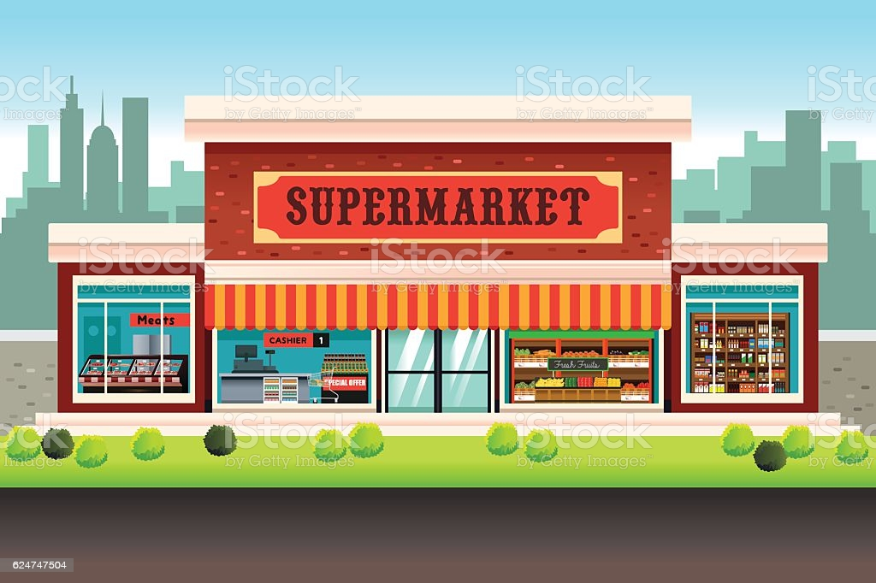
Purpose of the Database
The system aims to provide an end-to-end cooking experience of different cuisines for app users including recipe selection, grocery shopping and delivery
By picking a recipe, purchasing the necessary ingredients, and opting for doorstep delivery, users may effortlessly cook at home

Slide 3


Mission statement & Business problem
Provide a list of recipes with ingredients required for the Virtual Spatula app
Maintain a list of product availability for various shop inventories
Increase delivery efficiency by designating the appropriate delivery partner based on location

Slide 4
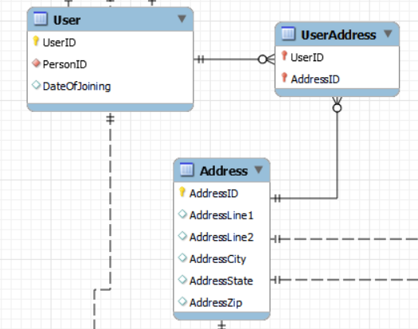
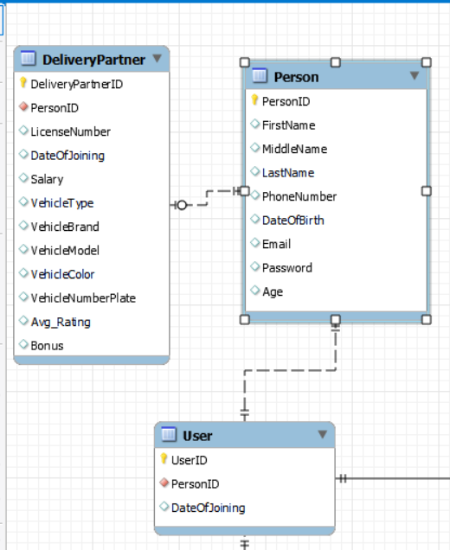
Business Rules
One user can have multiple addresses. One address can be shared by multiple
users
2. A person can be a user, a delivery partner or
both

Slide 5
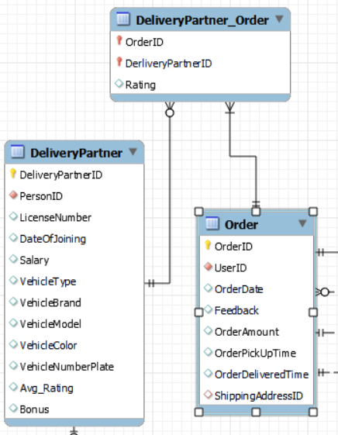
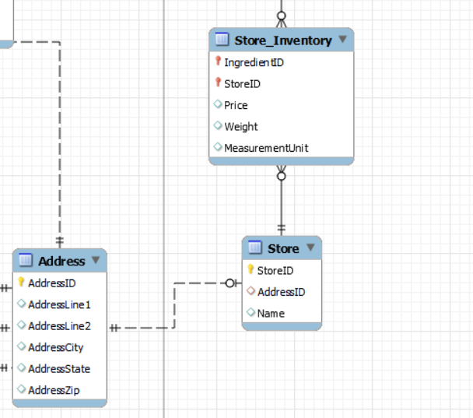
Business Rules
3. If a delivery partner faces issues during delivery, another delivery partner should be
assigned to the order.
4. A non-operational store can be present in the database for future collaborations.

Slide 6
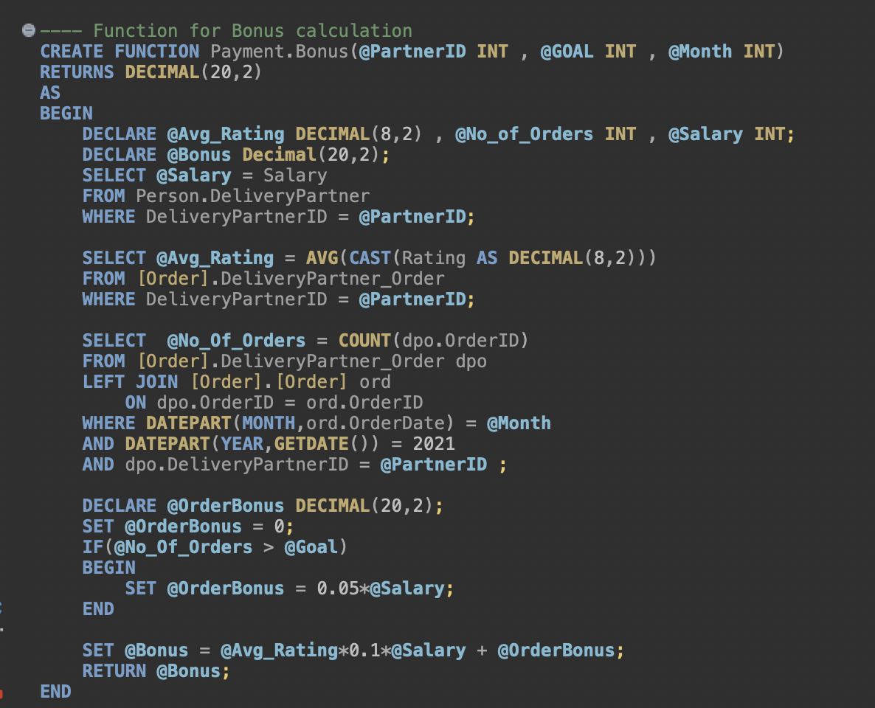
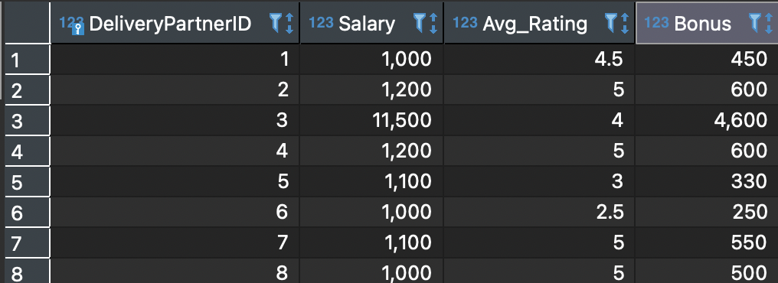
Computed Column - Bonus of Delivery Partner
Bonus of Delivery Partner is calculated as:
10% of Salary * Average Rating (Range 1-5)
5% of Salary if Monthly Goal is achieved
*Age Computed Column

Slide 7
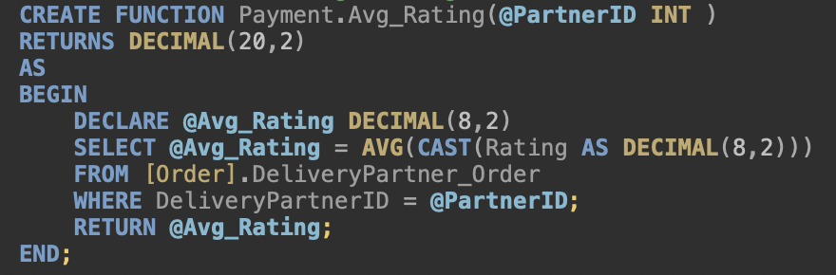
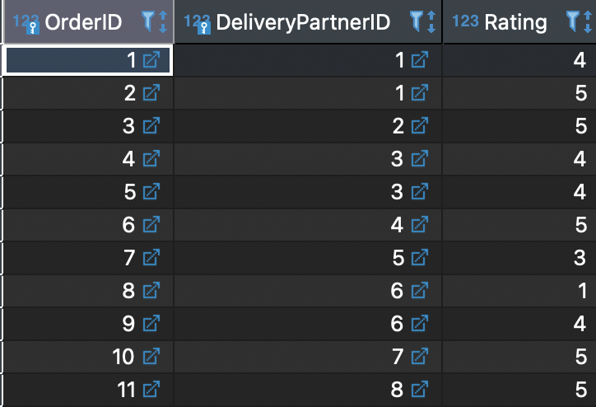
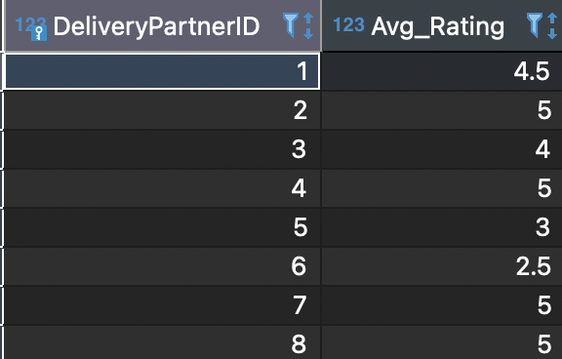
Computed Column- Average Rating
Average Rating is calculated as:
--Each delivery partner is given a rating by the customer for each order.
--We used this ratings to calculate the average rating.

Slide 8
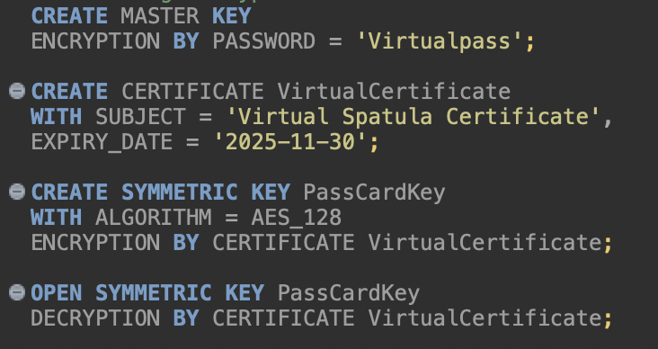
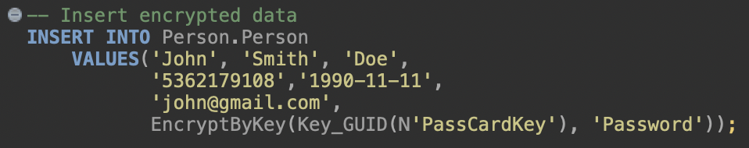
Encrypted Column - Password And Card Number
Created encrypted columns to store password of the users to maintain personal information security
To securely store payment card numbers, they are encrypted using symmetric key and AES 128 encryption algorithm

Slide 9
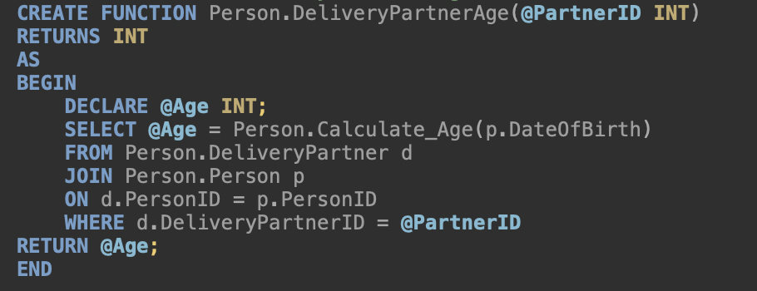
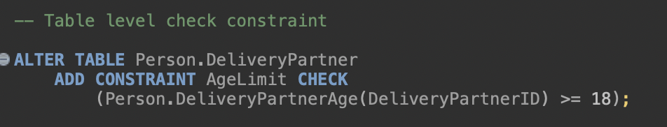
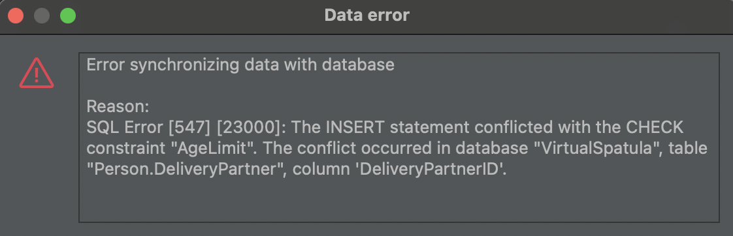
Table Level Check Constraint - Delivery Partner Age
Table level check constraint on DeliveryPartner table to check if a Person is 18 years old

Slide 10
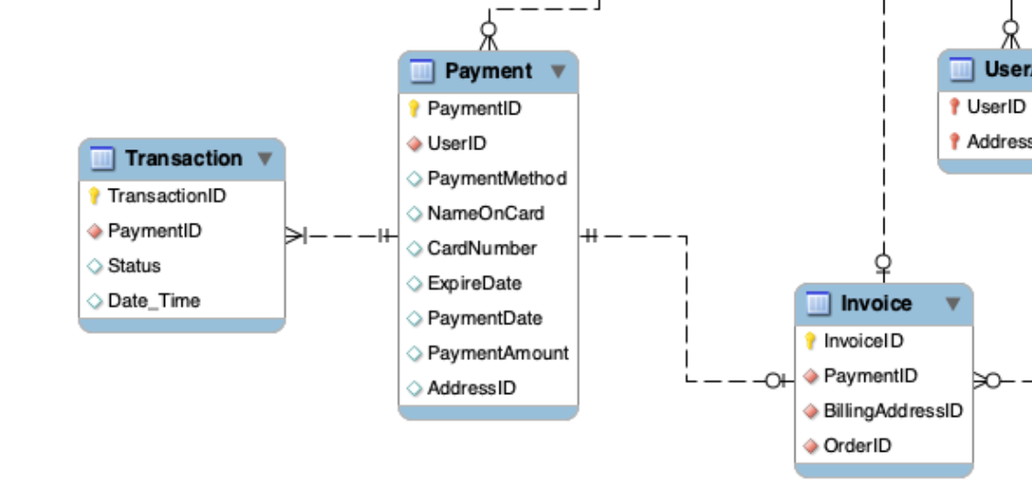
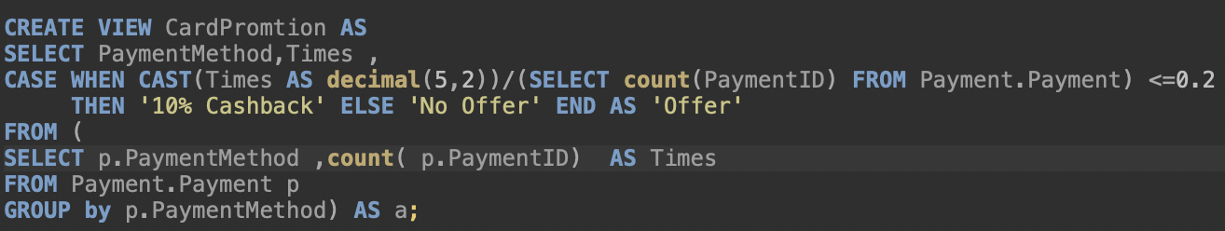
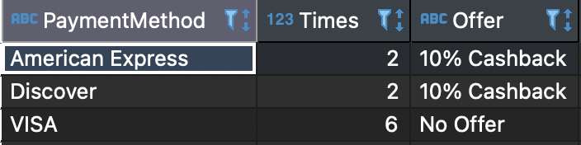
Payment Method Promotion - View
Promotions can be added to Payment methods that are used less frequently
Provide cashback if a Payment method is used in less than or equal to 20% transactions
Can be used as a report to negotiate promotions with credit card companies such as VISA, American Express, and etc.

Slide 11
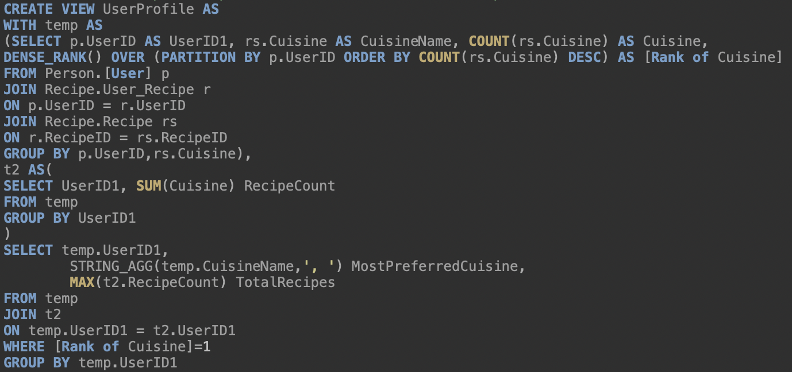
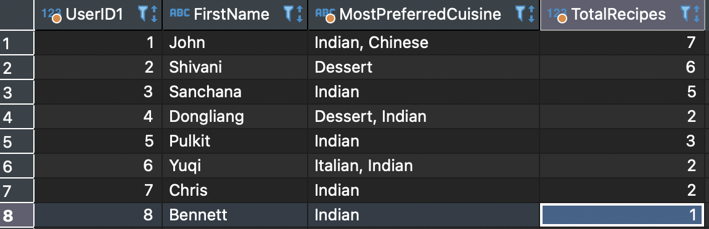
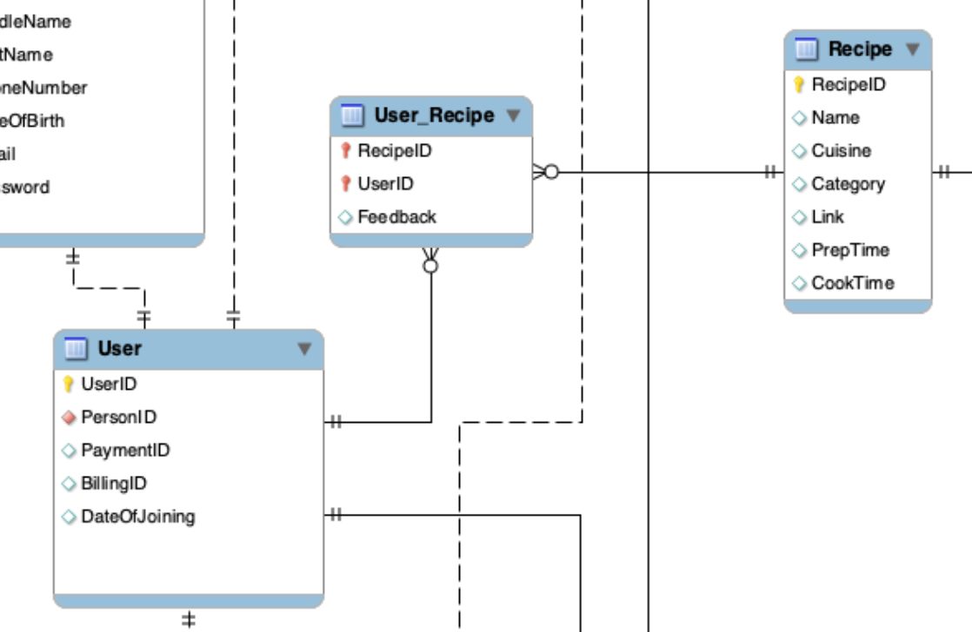
User Profile - View
Displays the most preferred cuisine and total number of recipes per user.
Can be used to provide promotions and recommend new recipes.

Slide 12
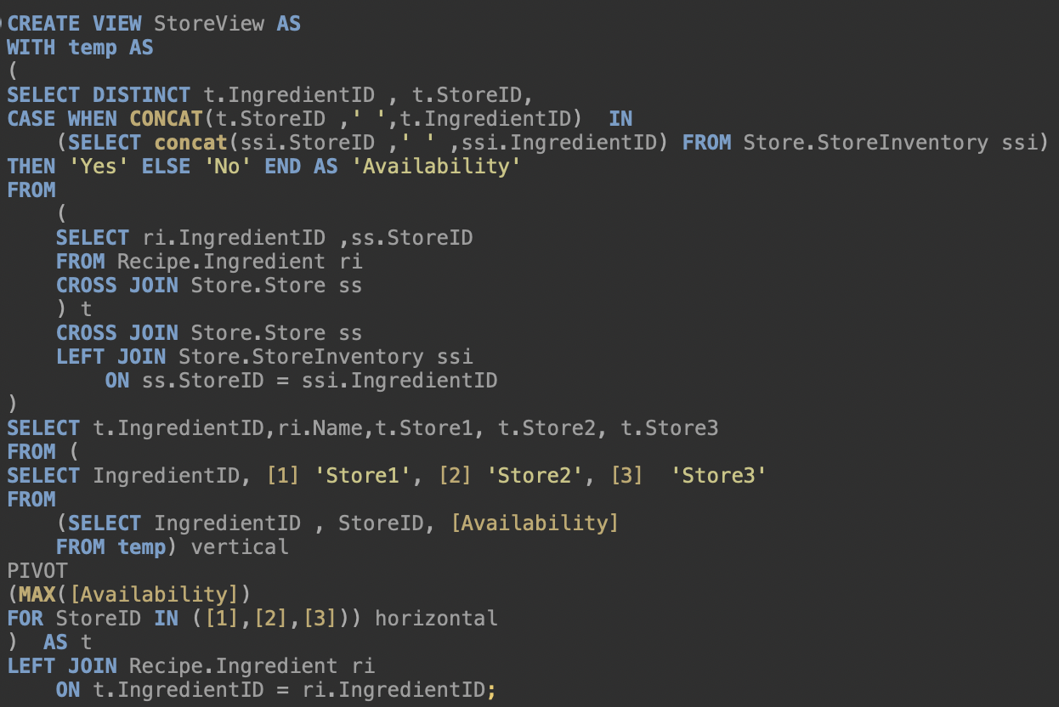
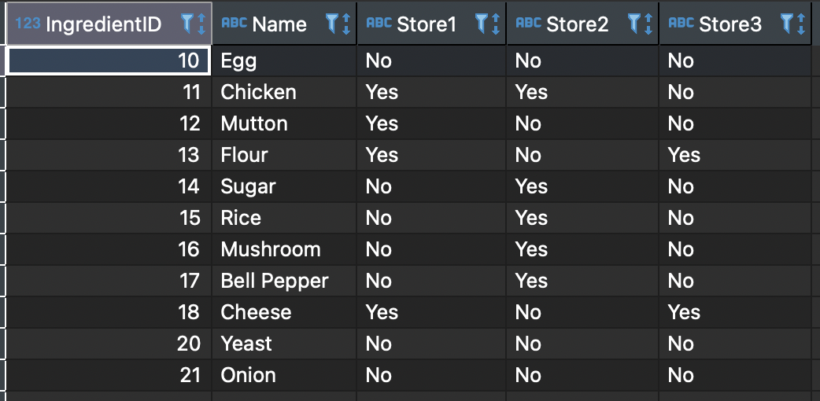
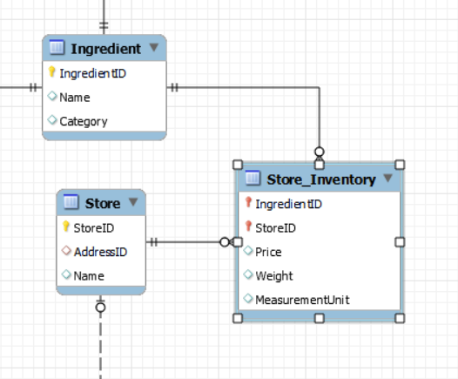
Store Inventory -View
Displays the availability of ingredients in stores

Slide 13
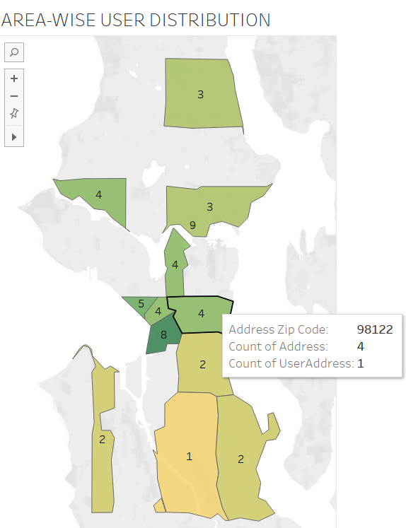

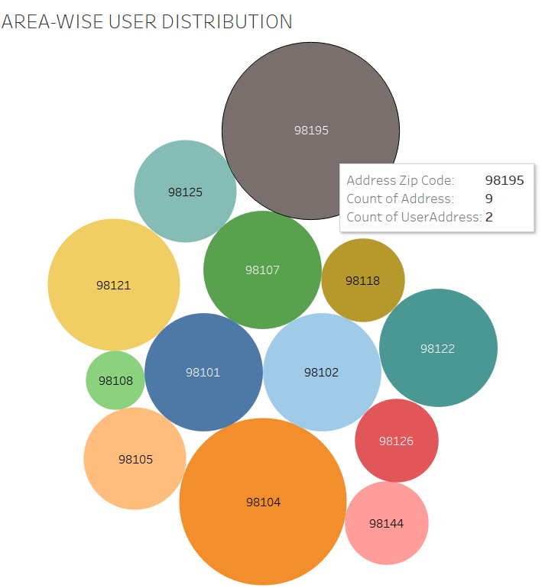
Distribution of Users in Seattle Area
Below Bubble chart shows the relational values. Size of bubble represents the count of users in each area
Uses of this report:
Assignment of delivery partners to different areas based on the user concentration
Collaboration with new stores in the user concentrated areas
Above Geographical map reveals the concentration of users in different areas of Seattle

Slide 14
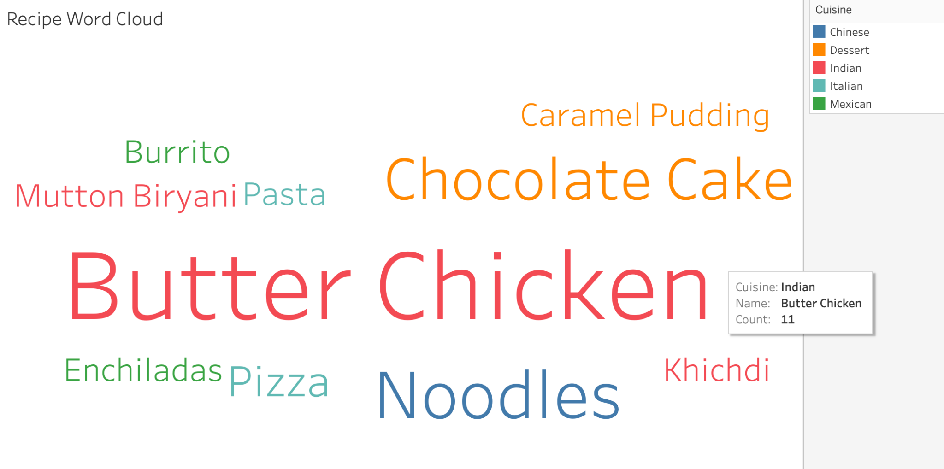
Recipe Word Cloud
The recipe word cloud visualisation helps us to see which recipe has been ordered the most.
This analysis/report can be useful in determining what type of new dish should be added to the database based on the most often ordered recipes and their relevant cuisines.

Slide 15
THANK YOU

